Slide 1

User participation AND ASSESSMENT METHODS IN risk management process
Seminar 2
By Jonathan ASHMORE
TEAM 3

Slide 2
What do the authors list as the advantages of involving users in the risk management process?
Helps users understand process in risk management
Helps users to relate to benefits of the RM processes.
Increases accountability
knowledge of security threats and controls > increase overall security (Ahmed, 2022)
“I think it definitely made us more aware of some of the risks that are out there and what we need to do to remediate them.”

Slide 3
QUANTITATIVE AND QUALITATIVE ASSESSMENT
Quantitative | Qualitative
Specific | Subjective
Accurate | Author-based
Time-consuming | Less complicated

Slide 4
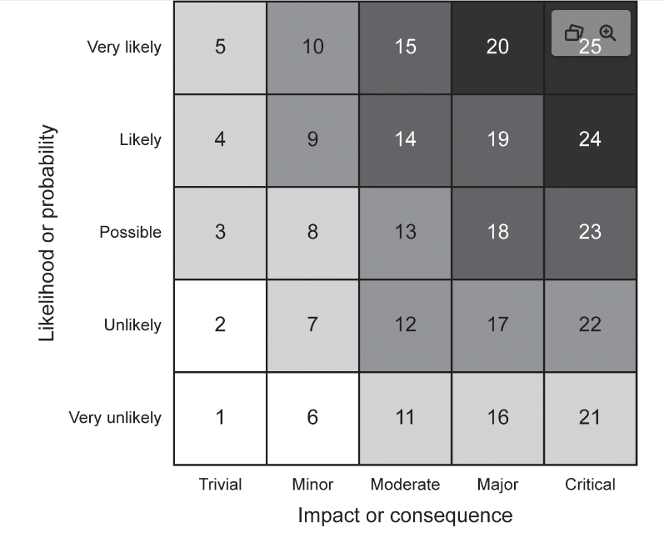
semi-quantitative
Sutton (2021) suggests qualitative scale with quantitative values such as this risk matrix:

Slide 5
rEFerences
Ahmed, A. (2022) Collaborative Learning Discussion 1 [Forum]. Available from: https://www.my-course.co.uk/mod/hsuforum/discuss.php?d=314220. Accessed 23 June 2022).
Spears, J. & Barki, H. (2010) User Participation in Information Systems Security Risk Management. MIS Quarterly 34(3): 503.
Sutton, D. (2021) Information risk management: a practitioner’s guide. London: Bcs.. Available via the Vitalsource Bookshelf. [Accessed 23 June 2022].
‌

